Slide 1


Molecular Dynamics Simulations of the Polariton Transport
Sokolovskii Ilia, University of Jyvaskyla, Chemistry Department
2022

Slide 2


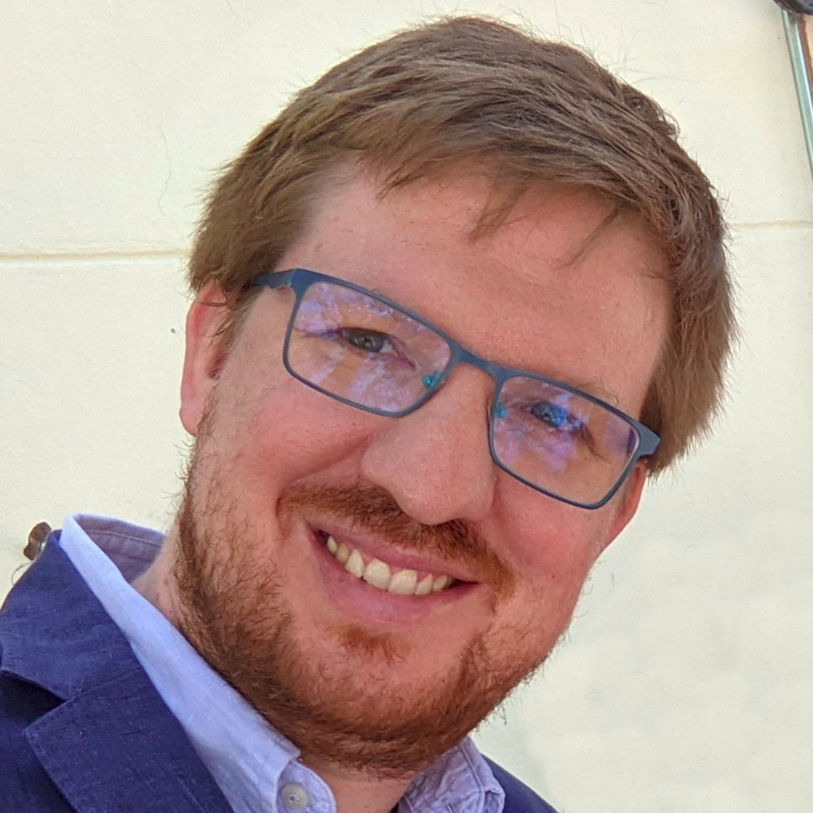



Acknowledgements
Gerrit Groenhof
Ruth Tichauer
Johannes Feist

Slide 3
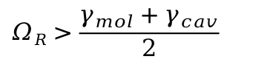
Interactions between a molecule and a photon
in free space
in a cavity
hν
hν
hν
Ω_{R}
absorption
exciton
emission
Me
Me
Me
Me
Me
Me
Me
Me
Me
weak coupling
Me
excitation decay
cavity leakage
$$ΩR>\frac{γ_{mol}+γ_{cav}}{2}$$
strong coupling

Slide 4
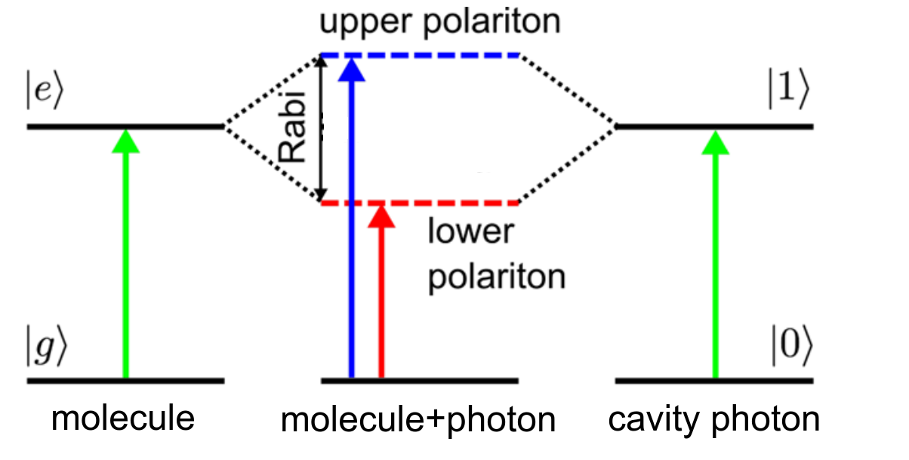
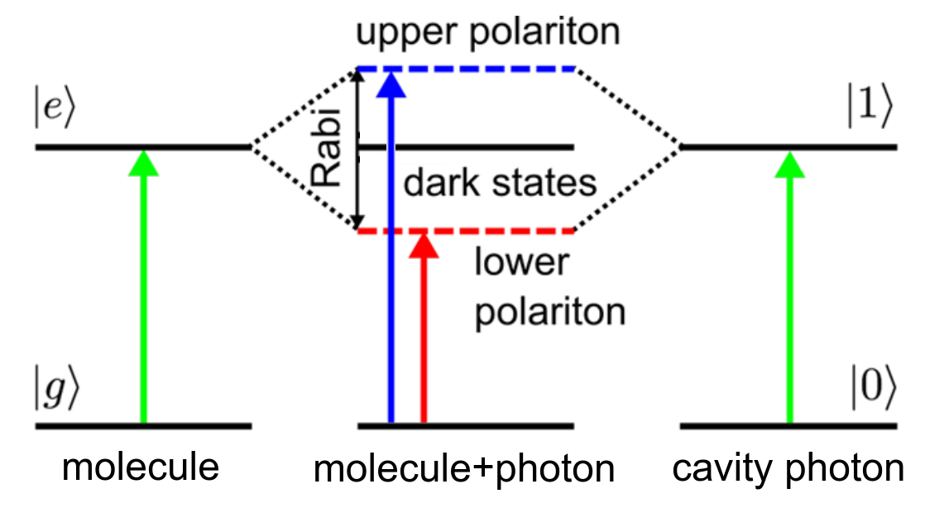
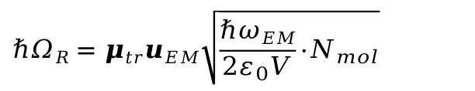
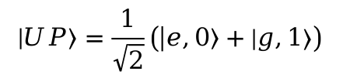
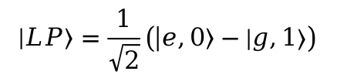
Strong coupling phenomenon
At the strong coupling, two hybrid states (polaritons) inheriting properties of both the exciton and the cavity photon emerge.
N_{mol} = 1, n_{mode} = 1:
When N_{mol} > 1, the dark states appear
N_{DS} = N_{mol} - n_{mode}
G. Groenhof et al., H, J. Phys. Chem. Lett., 2019, 10, 18, 5476–5483.
$$\left|\left.LP\right\rangle \right.=\frac{1}{\sqrt{2}}\left(\left|\left.e,0\right\rangle −\left|\left.g,1\right\rangle \right.\right.\right)$$
$$\left|\left.UP\right\rangle \right.=\frac{1}{\sqrt{2}}\left(\left|\left.e,0\right\rangle +\left|\left.g,1\right\rangle \right.\right.\right)$$

Slide 5
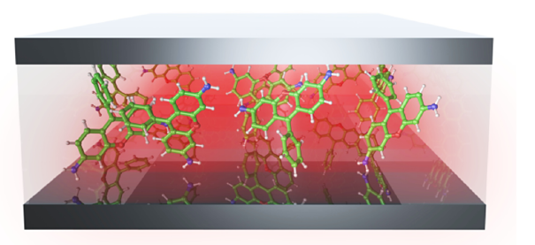
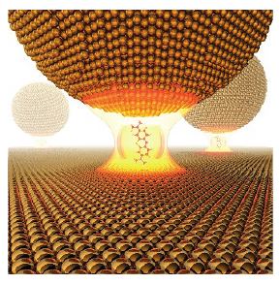
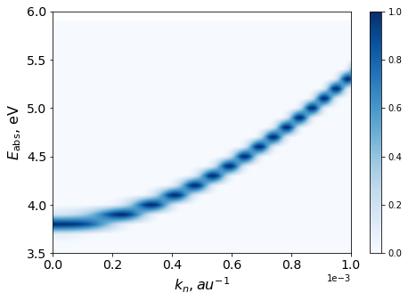
Strong coupling phenomenon
Theory
Experiments
- describes chemistry for a single (or several) molecule
- N > ~1000 — too expensive
- usually a single cavity mode is treated
- deal with huge molecular ensembles
- N ≤ ~1000 — difficult to achieve
J. Phys. Chem. Lett., 2019, 10, 5476−5483
?
Nature, 2016, 535, 127–130
Theoretical studies
Computer simulations
Experiments
Requirements:
treat as many molecules as possible
multiple cavity modes (dispersion)
to choose an appropriate method

Slide 6
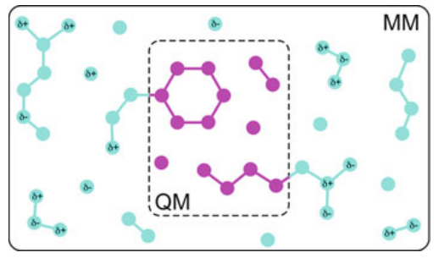
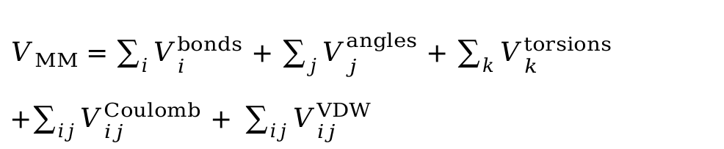
Quantum mechanics/Molecular mechanics (QM/MM)
A system in study is separated in two parts:
- Quantum mechanical (QM) part → ab inito methods
- Molecular mechanical (MM) part → mechanical force fields
$V_{MM}=\sum_{i}{V_{i}^{bonds}}$ + $\sum_{j}{V_{j}^{angles}}$ + $\sum_{k}{V_{k}^{torsions}}$ +$\sum_{ij}{V_{ij}^{Coulomb}}$ +$\sum_{ij}{V_{ij}^{VDW}}$
Connection between QM and MM parts:
$V_{QM/MM}=V_{QM}$ + $V_{MM}$ + $V_{QM−MM}$
Methods Mol Biol., 2013, 924, 43-66.
atoms not (directly) involved in a chemical process
atoms involved in a chemical process

Slide 7


Quantum mechanics/Molecular mechanics (QM/MM)
QM atoms:
ground excited state energies
first excited state energies
transition dipole moments
Energies of MM atoms
Cavity dispersion
Light-matter interactions
Dynamics
Modified Gromacs code
(https://github.com/rhti/gromacs_qed)

Slide 8
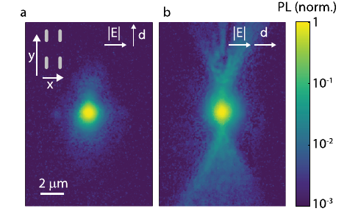
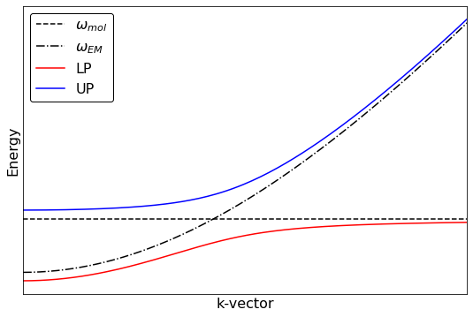
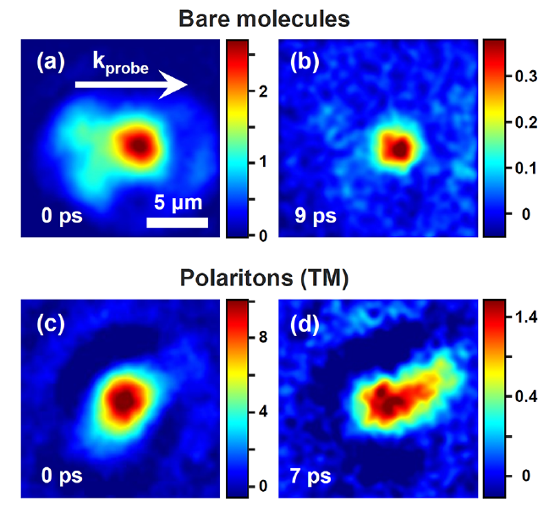
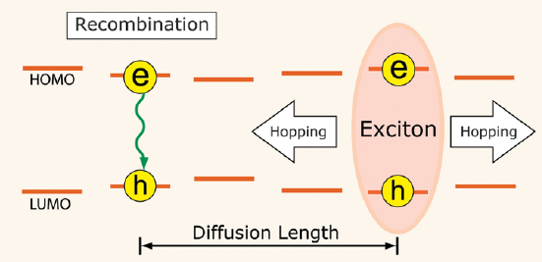
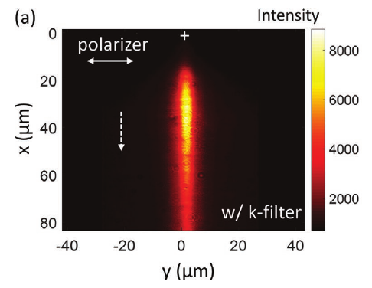
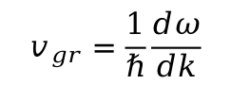
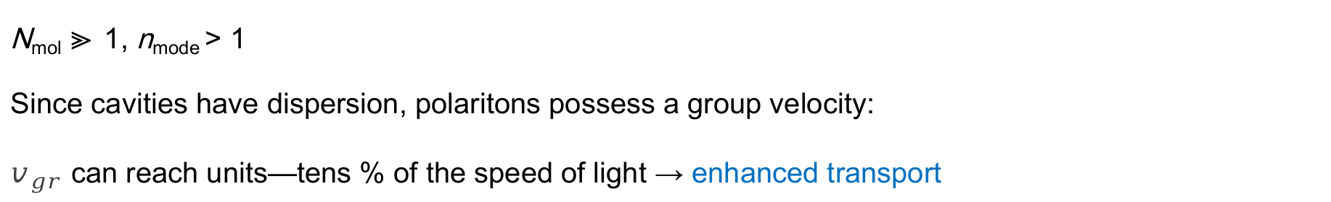
Motivation to study polariton transport
N_{mol} ≫ 1, n_{mode} > 1
Since cavities have dispersion, polaritons possess a group velocity:
$v_{gr}$ can reach units—tens % of the speed of light → enhanced transport
$$v_{gr}=\frac{1}{ℏ}\frac{dω}{dk}$$
(for organic solar cells)
For most organic materials, L_{d} ~ 5-10 nm
ACS Photonics, 2022, 9, 7, 2263–2272
ACS Photonics, 2018, 5, 1, 105–110.
Energy Environ. Sci., 2015, 8, 1867.
Adv. Mater., 2020, 32, 28, 2002127
Adv. Mater., 2020, 32, 28, 2002127

Slide 9

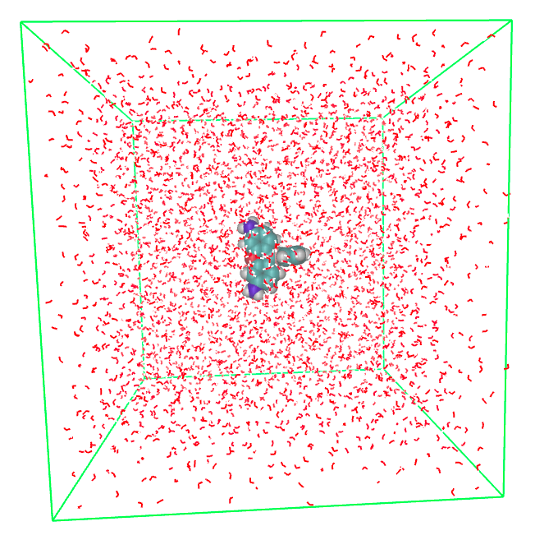
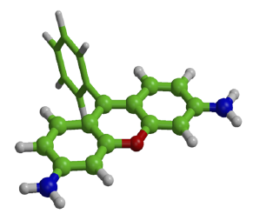
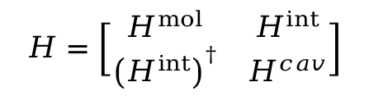
Simulations of polariton transport
$$H=\sum_{j}^{N}{V_{S1}^{mol}\left(R_{j}\right)}+\sum_{i}^{N}{V_{S_{0}}}\left(R_{i}\right)+\sum_{k_{z}}^{n_{mode}}{ℏω_{cav}}\left(k_{z}\right)+\sum_{j}{\sum_{k_{z}}{μ_{j}\left(R_{j}\right)u_{cav}\sqrt{\frac{ℏω_{cav}\left(k_{z}\right)}{2ε_{0}V_{cav}}}e^{ik_{z}z_{j}}}}$$
$$H=\left[\begin{matrix}H^{mol} & H^{int} \\ {\left(H^{int}\right)}^{†} & H^{cav}\end{matrix}\right]$$
molecular part
ground state
cavity part
light-matter interactions
Rhodamine molecules in water solution
Classical subsystem
(Amber03-ff)
Quantum mechanical subsystem
(S₀ - RHF/3-21G, S1 - CIS/3-21G)

Slide 10
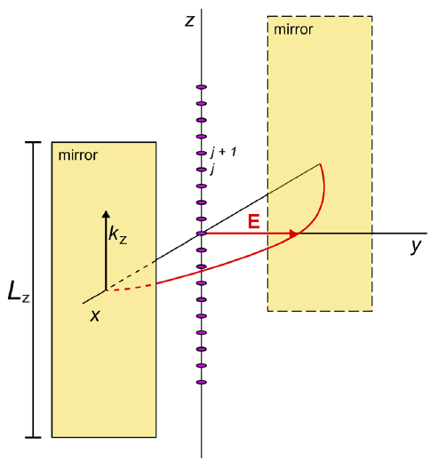
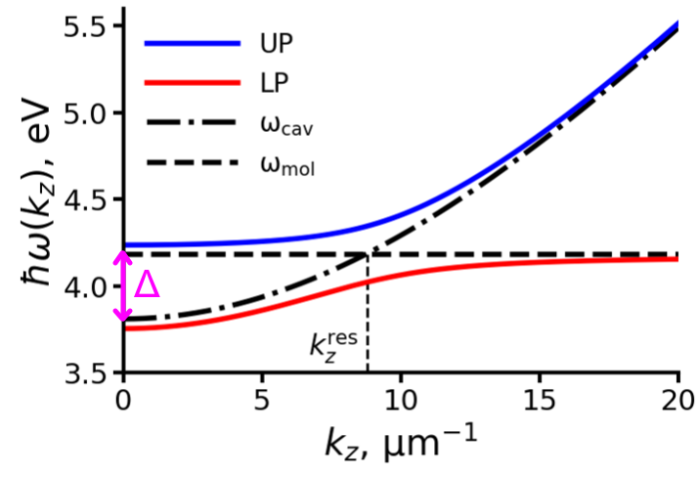
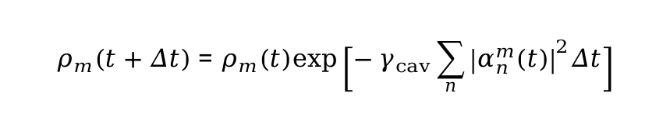
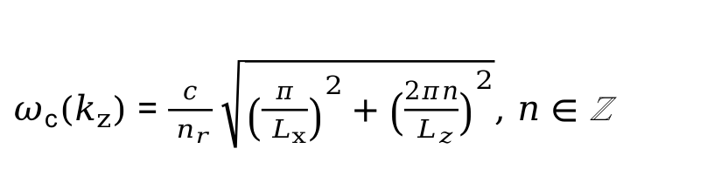
Simulations of polariton transport
$$H=\sum_{j}^{N}{V_{S1}^{mol}\left(R_{j}\right)}+\sum_{i}^{N}{V_{S_{0}}}\left(R_{i}\right)+\sum_{k_{z}}^{n_{mode}}{ℏω_{cav}}\left(k_{z}\right)+\sum_{j}{\sum_{k_{z}}{μ_{j}\left(R_{j}\right)u_{cav}\sqrt{\frac{ℏω_{cav}\left(k_{z}\right)}{2ε_{0}V_{cav}}}e^{ik_{z}z_{j}}}}$$
$$H=\left[\begin{matrix}H^{mol} & H^{int} \\ {\left(H^{int}\right)}^{†} & H^{cav}\end{matrix}\right]$$
molecular part
ground state
cavity part
light-matter interactions
Main parameters:
L_{z} = 50 μm - cavity length
N _{mol}= 1024 - number of molecules
n_{modes} = 160 (0⩽n⩽159) - number of modes
E_{c}^{max} ~ 5.5 eV - cavity energy cut-off
hν = 4.18 eV - excitation energy of Rhodamine
Δ = 370 meV - cavity detuning
ℏΩ_{R} = 325 meV - Rabi splitting
γ_{cav} = 66.7 ps⁻¹ - cavity decay rate
$ω_{c}\left(k_{z}\right)=\frac{c}{{ n}_{r}}\sqrt{{\left(\frac{π}{{ L}_{x}}\right)}^{2}+{\left(\frac{2πn}{{ L}_{z}}\right)}^{2}}$, $n∈$ ℤ
$$ρ_{m}\left(t+Δt\right)=ρ_{m}\left(t\right)exp\left[−γ_{cav}\sum_{n}{{\left|α_{n}^{m}\left(t\right)\right|}^{2}Δt}\right]$$

Slide 11
Simulations of polariton transport
$$H=\sum_{j}^{N}{V_{S1}^{mol}\left(R_{j}\right)}+\sum_{i}^{N}{V_{S_{0}}}\left(R_{i}\right)+\sum_{k_{z}}^{n_{mode}}{ℏω_{cav}}\left(k_{z}\right)+\sum_{j}{\sum_{k_{z}}{μ_{j}\left(R_{j}\right)u_{cav}\sqrt{\frac{ℏω_{cav}\left(k_{z}\right)}{2ε_{0}V_{cav}}}e^{ik_{z}z_{j}}}}$$
$$H=\left[\begin{matrix}H^{mol} & H^{int} \\ {\left(H^{int}\right)}^{†} & H^{cav}\end{matrix}\right]$$
molecular part
ground state
cavity part
light-matter interactions

Slide 12
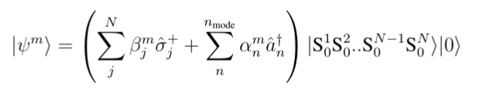
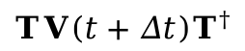
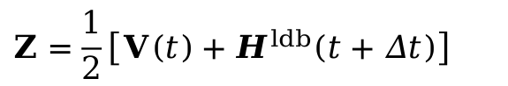
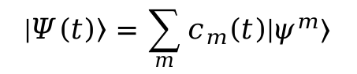
Simulations of polariton transport
diagonalise hamiltonian → eigenfunctions
total wave function is expanded in the basis of the polaritonic states:
$$|\left.Ψ\left(t\right)\right\rangle =\sum_{m}{c_{m}\left(t\right)|\left.ψ^{m}\right\rangle }$$
Expanstion coefficients c_{m}(t) are integrated in a (stable) local diabatic basis* :
$c\left(t+Δt\right)=T^{†}exp\left[−iZΔt\right]c\left(t\right)$ with
$T=S{\left(S^{T}S\right)}^{−1/2}$, where $S_{ml}=\left\langle ψ^{m}\left(t\right) | ψ^{l}\left(t+Δt\right)\right\rangle$
$$Z=\frac{1}{2}\left[V\left(t\right)+H^{ldb}\left(t+Δt\right)\right]$$
eigenvalues of H
$$TV\left(t+Δt\right)T^{†}$$
*) J. CHem. Phys. 114 (2001) 10608

Slide 13
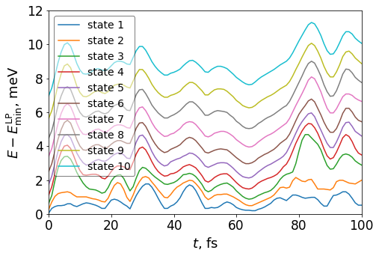
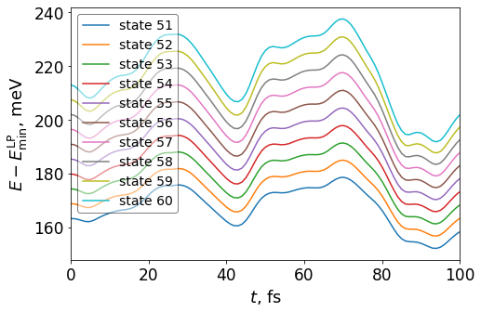
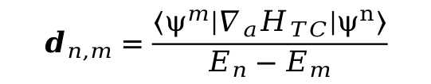
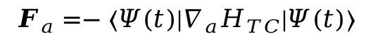
Simulations of polariton transport
Ehrenfest dynamics
Hellmann–Feynman theorem:
$$F_{a}=−\left\langle Ψ\left(t\right) | {∇_{a}H}_{TC} | Ψ\left(t\right)\right\rangle$$
non-adiabatic couplings are calculated:
$$d_{n,m}=\frac{\left\langle ψ^{m} | {∇_{a}H}_{TC} | ψ^{n}\right\rangle }{E_{n}−E_{m}}$$

Slide 14
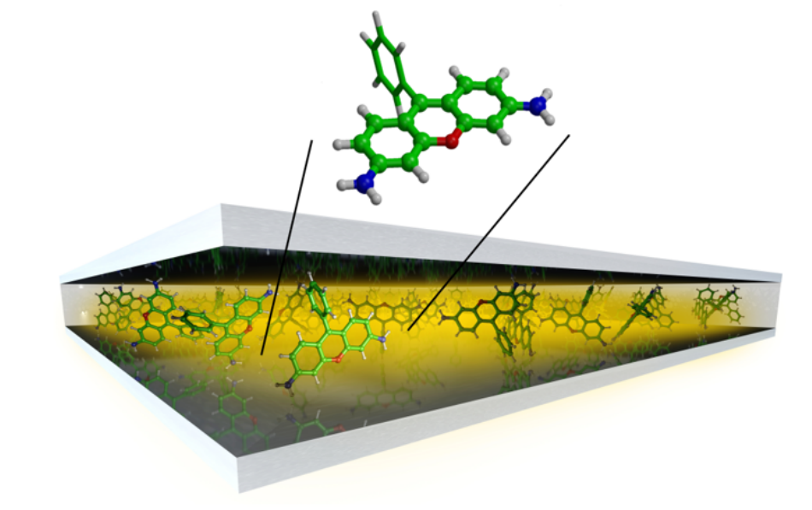
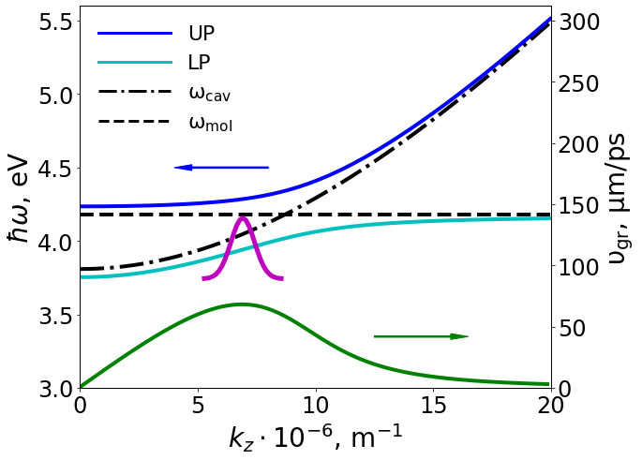
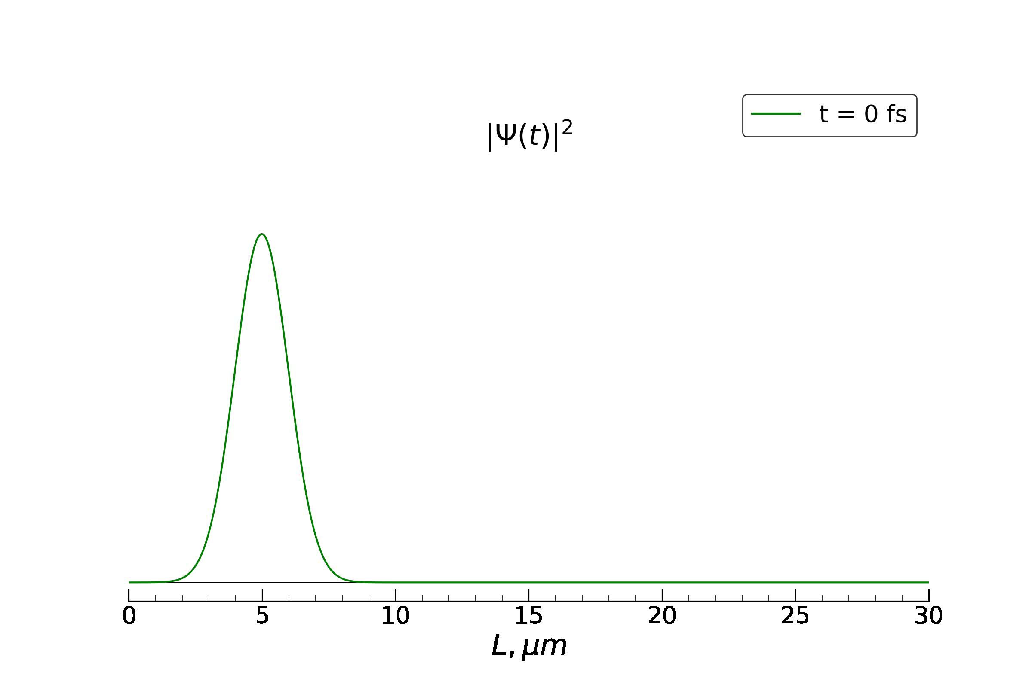
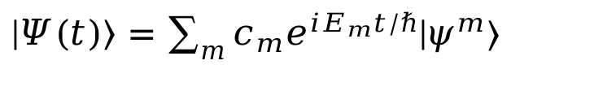

Results
1) Resonant (direct) excitation of polaritons
$\left.|Ψ\left(t\right)\right\rangle =\sum_{m}{c_{m}e^{iE_{m}t/ℏ}\left.|ψ^{m}\right\rangle }$
$$c_{m}\left(0\right)\sim e^{−β\left(k_{m}−k_{0}\right)}$$

Slide 15
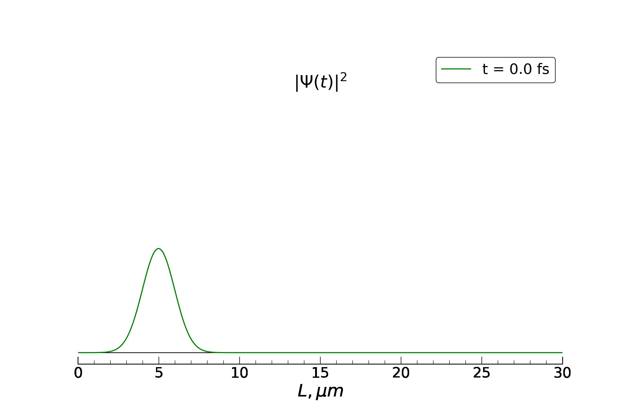
Results
1) Resonant (direct) excitation of polaritons
QM/MM simulations:
$$c_{m}\left(0\right)\sim e^{−β\left(k_{m}−k_{0}\right)}$$
μm-scale propagation
influence of vibronic transitions and disorder

Slide 16
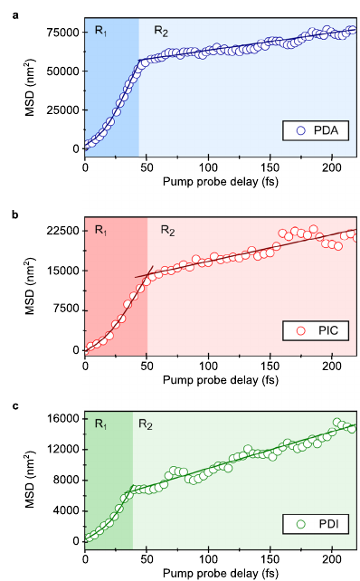
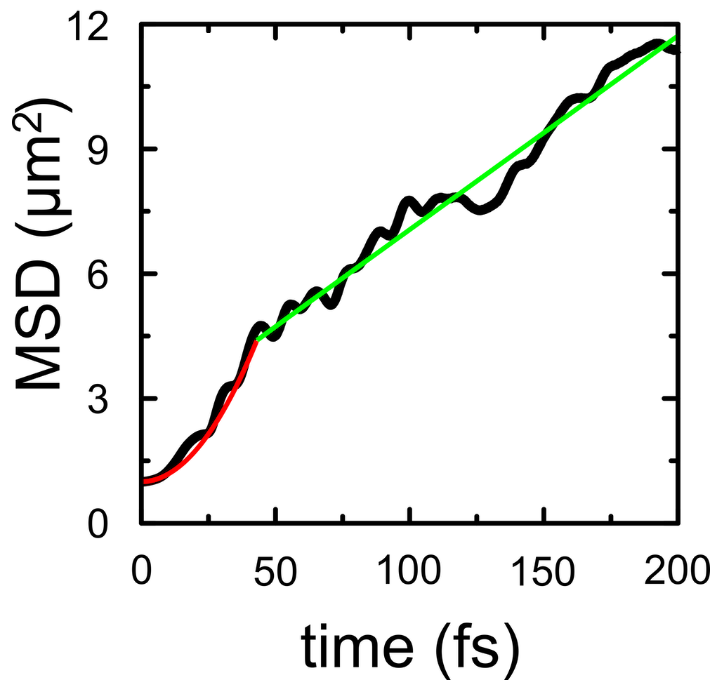
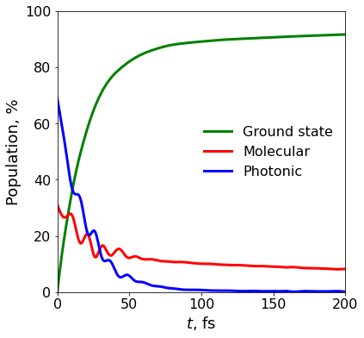
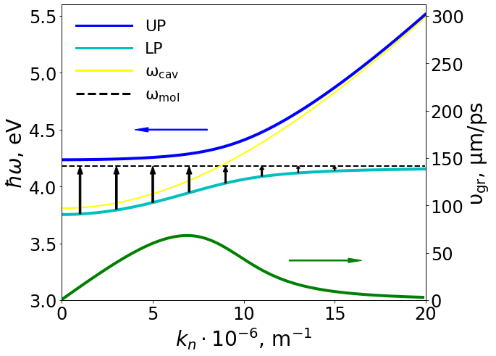
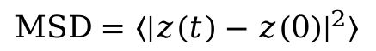
Results
2) Resonant excitation
$$MSD=〈{|z(t)−z(0)|}^{2}〉$$
ballistic transport of the initial wave packet
transition to ballistic motion at t ~ 40 fs
Nat. Commun., 2021, 12, 6519

Slide 17
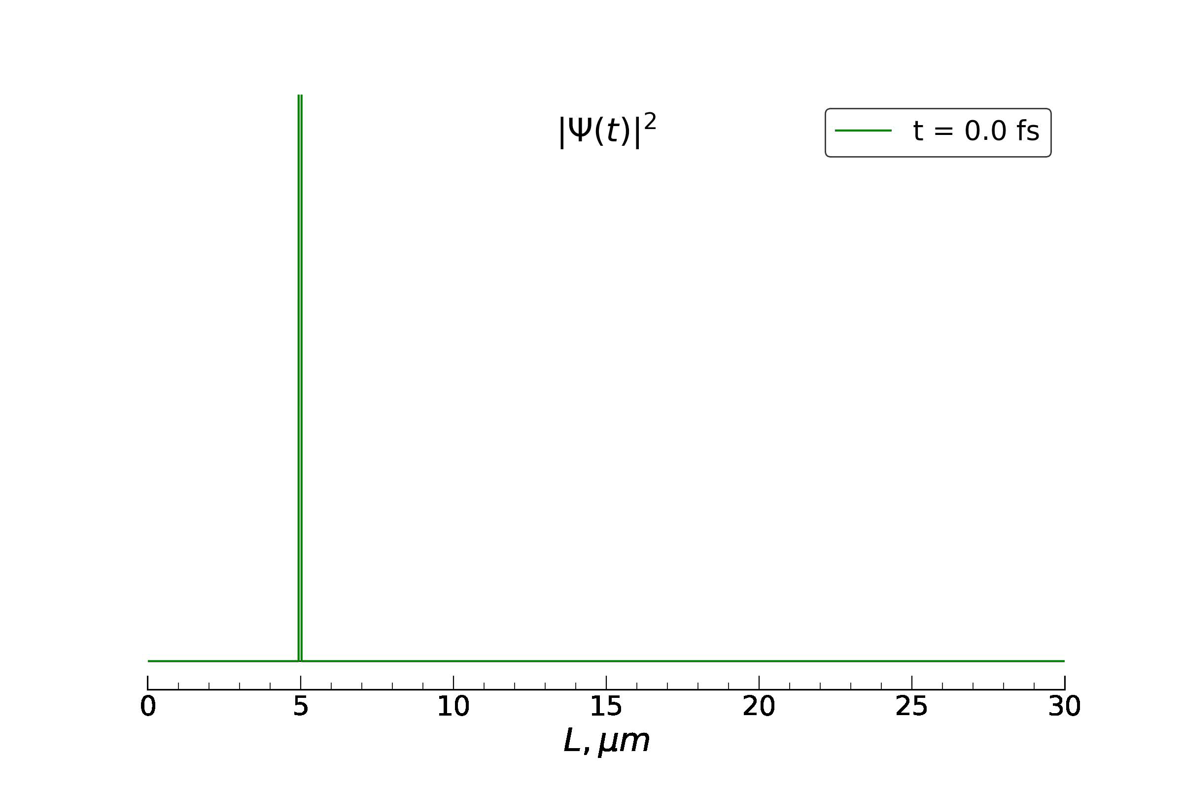
Results
2) Off-resonant (indirect) excitation
E_{n}
E_{UP}
E₁
E_{LP}
E₀
1. excitation
2. fast relaxation to E₁
3. relaxation to the ground state
4. feeding upper and lower polaritons

Slide 18
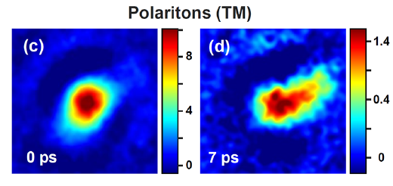
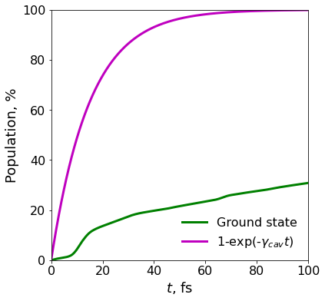
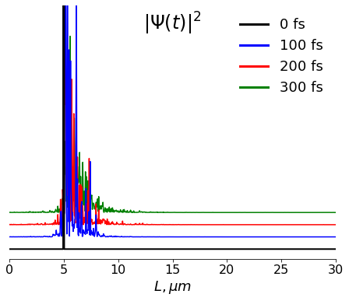
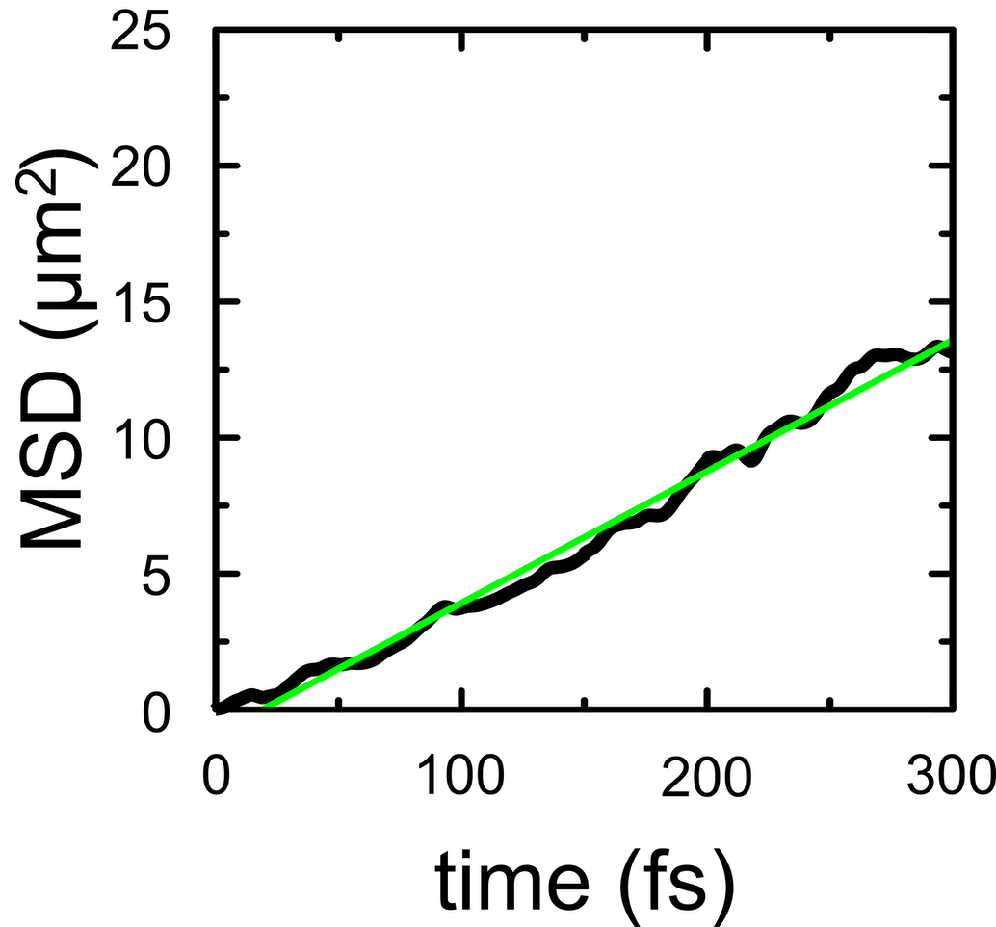
Results
2) Off-resonant excitation
Cavity decay:
propagation is of the μm-scale
polaritons survive for much longer than ascribed by the cavity lifetime (τ_{cav} = 15 fs)

Slide 19
Summary
Polariton propagation was studied by means of QM/MM simulations
The transport is of μm-range, which is 2−3 orders of magnitude higher than the diffusion length of typical organic materials
Polaritons can survive much longer than the cavity lifetime due to the dark states
We believe that these findings will help rationally design of molecule-cavity systems for achieving coherent long-range energy transport

Slide 20
References
IRENA 2016: https://www.irena.org/publications/2016/Jun/End-of-life-management-Solar-Photovoltaic-Panel
IEA 2022: https://iea-pvps.org/wp-content/uploads/2022/09/PVPS_Trend_Report_2022.pdf
NREL chart: https://www.nrel.gov/pv/cell-efficiency.html

Slide 21
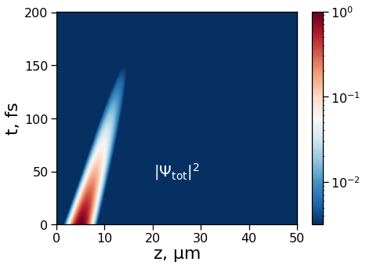


Results
1) Resonant excitation
$\left.|Ψ\left(t\right)\right\rangle =\sum_{m}{c_{m}e^{iE_{m}t/ℏ}\left.|ψ^{m}\right\rangle }$
analytical solution with disorder (σ = 0.05 eV, average of 50 runs)
full MD

